Slide 1
Artistry in Focus: Order Process Workflow
IT299 Unit 5 Planning Phase Review Presentation
Michael Sullivan
IT299: Integrative Project
Prof. Andrew Mooney
December 12, 2024
Notes:
Welcome, everyone! Thank you for joining me for the Planning Phase Review for our Artistry in Focus: Order Process Workflow project.
I’m Michael Sullivan, and today we’ll cover the project’s purpose, key milestones, challenges, and next steps.
Let’s dive in and review our progress so far!

Slide 2
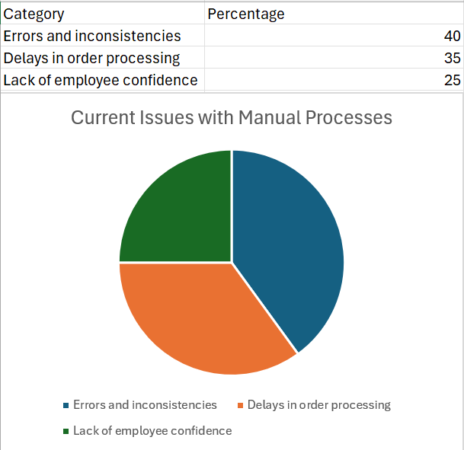
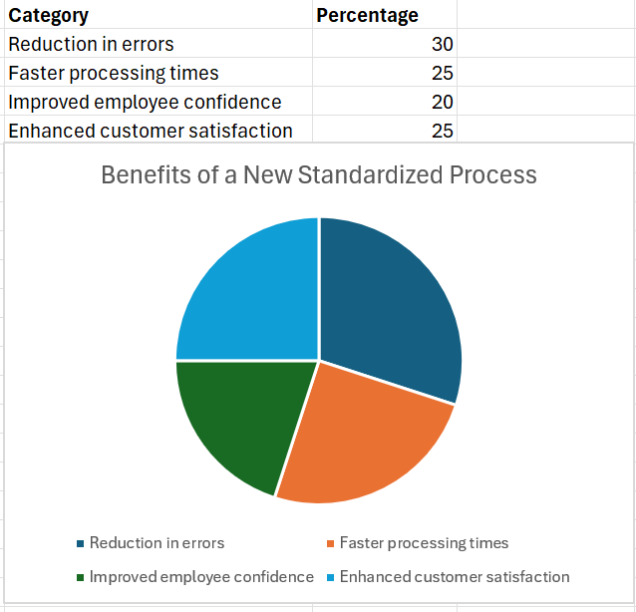
Why This Project Matters
Challenge: Manual processes lead to errors and delays.
Solution: Streamlined workflows and SOPs for efficiency.
Benefit: Faster order processing, fewer errors, and happier clients.
Notes:
Our current manual process creates errors and slows us down, especially with growing demand.
Streamlined workflows and SOPs will fix these issues and make us more efficient.
This means faster orders, fewer mistakes, and happier clients.

Slide 3
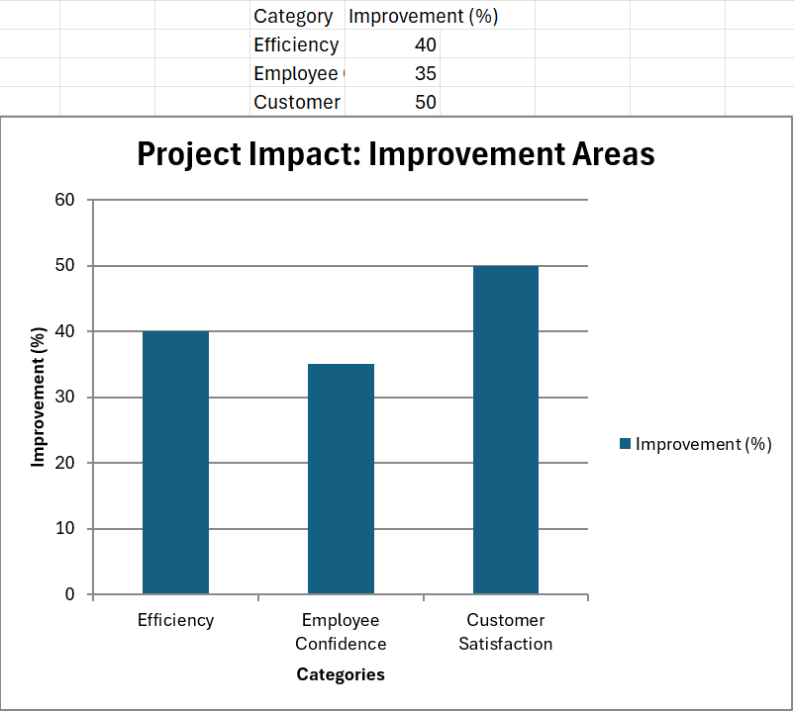
Project Goals
Primary Goals:
Standardize order processing.
Train employees for efficiency.
Increase customer satisfaction.
Key Deliverables:
Inquiry forms.
Standard Operating Procedures (SOPs).Training materials.
Notes:
We’re focused on simplifying order processes and giving our team the tools to work smarter. These changes will improve customer satisfaction and help us stay competitive.

Slide 4

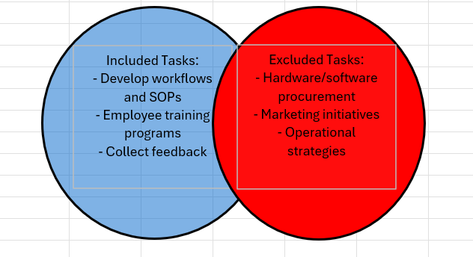
Scope of the Project
In Scope:
Develop workflows and create clear Standard Operating Procedures (SOPs).
Build training programs to help employees adapt quickly.
Gather feedback from employees and clients to improve the process.
Out of Scope:
Buying or setting up new hardware or software.
Any marketing or promotional activities.
Notes:
In Scope: We’re creating workflows, SOPs, training programs, and refining processes with feedback.
Out of Scope: No hardware purchases or marketing efforts—this keeps us focused.
Reassurance: Clear boundaries help us stay on track and deliver results.

Slide 5
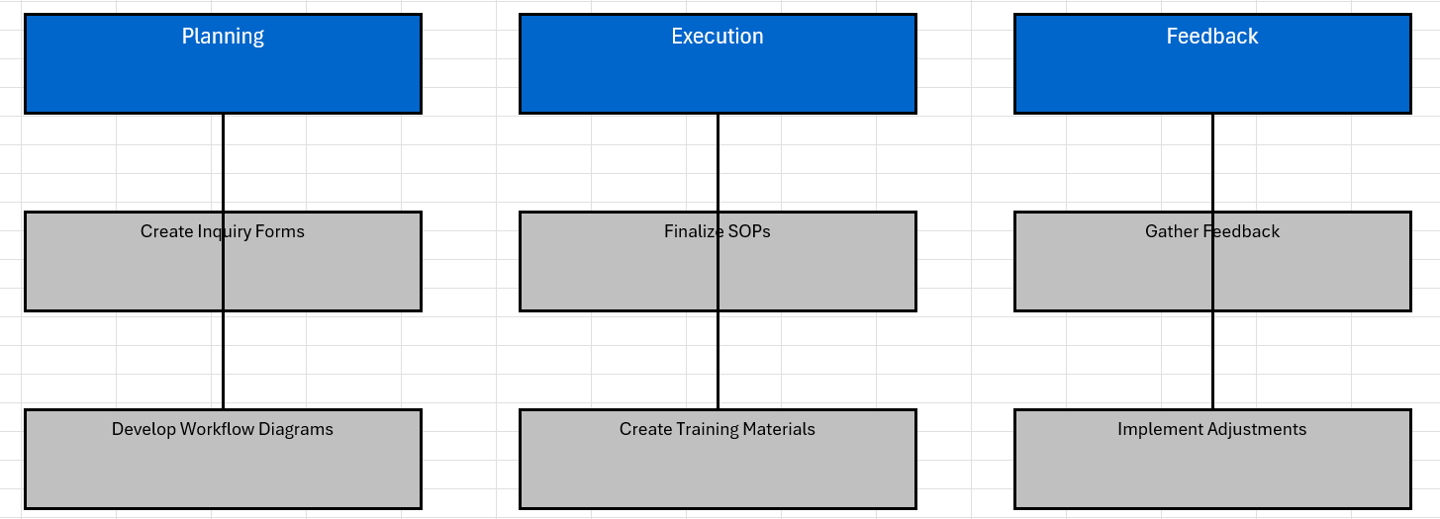
Work Breakdown Structure (WBS)
Phases:
Planning: Create inquiry forms and workflow diagrams to standardize the order process.
Execution: Develop SOPs and training materials to support smooth implementation.
Feedback: Collect insights from employees and clients to make necessary adjustments.
Key Dependencies:
SOPs must be finalized before training sessions can begin.
Notes:
Structure: The WBS has three phases: Planning, Execution, and Feedback, building sequentially for smooth progress.
Dependencies: SOPs must be ready before training, they’re the foundation for instruction.
Goals: This structure aligns tasks to streamline the order process efficiently.

Slide 6
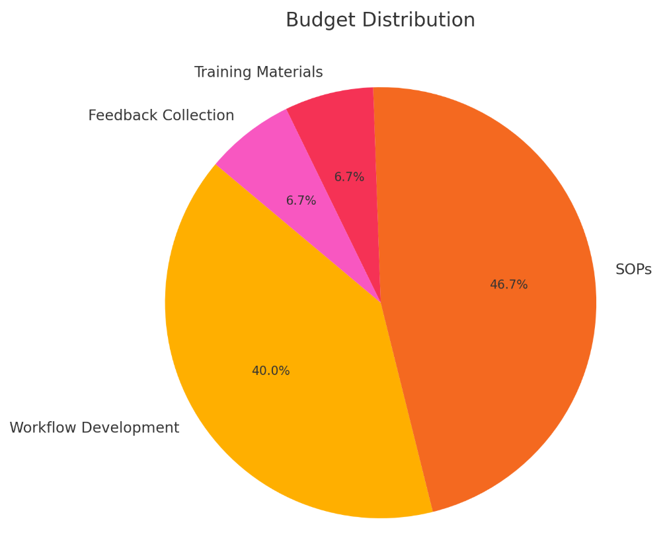
Budget Overview
Total Budget: $12,550
Cost Breakdown:
Workflow Development: $3,100
SOP Documentation: $2,500
Training Materials: $500
Feedback Collection: $500
Implementation (Installation & Testing): $4,670
Quality Assurance & Reviews: $1,680
Notes:
We’re working with a total budget of $12,550, and every dollar has been allocated to hit our main goals efficiently.
The bulk of the budget goes to workflow development and implementation since those are key to making this project a success.
We’ve also set aside funds for training, documentation, and feedback collection to ensure everything runs smoothly and is well-supported.
This plan makes sure we’re using resources wisely to deliver the best results.

Slide 7
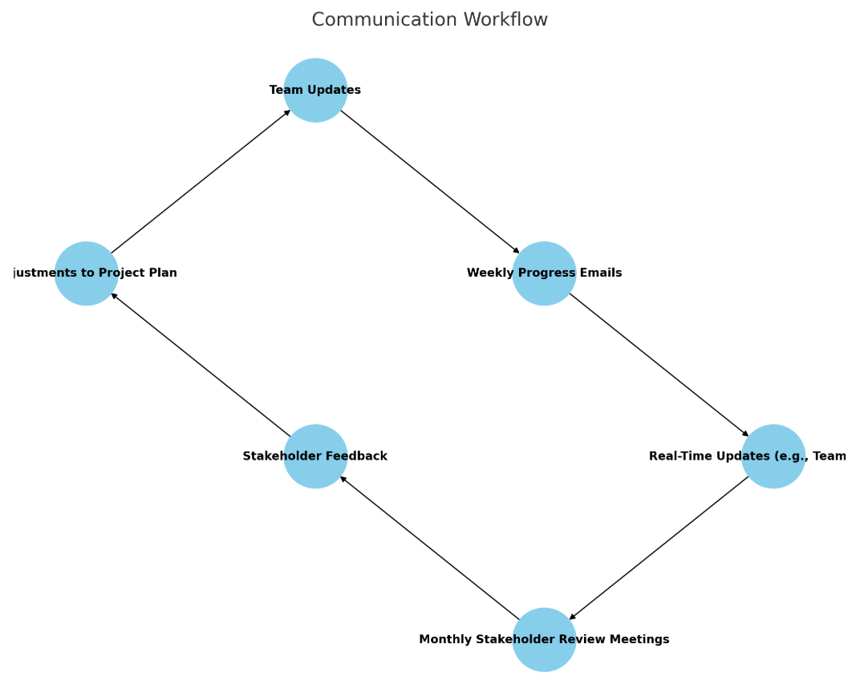
Communication Plan
Goals: Ensure all stakeholders are informed. Maintain progress updates for alignment and decision-making.
Methods: Weekly progress emails summarizing tasks and deliverables. Real-time updates through collaboration tools (e.g., Microsoft Teams, Slack).
Monthly stakeholder review meetings to address concerns and share milestones.
Notes:
Communication is critical to the project's success and stakeholder trust.
Weekly updates keep everyone aligned on progress and potential blockers.
Real-time tools ensure immediate responses to challenges.
Monthly meetings offer an opportunity for feedback and adjustments, fostering collaboration.

Slide 8
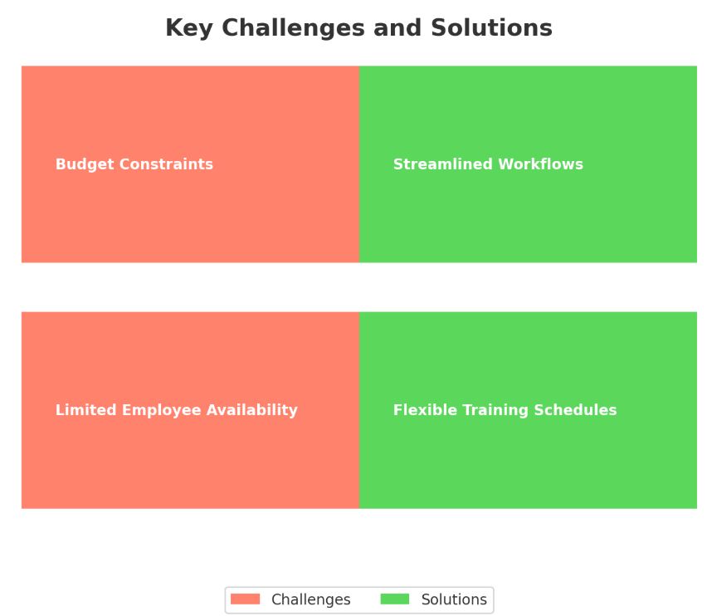
Key Challenges and Solutions
Challenges:
Limited employee availability during peak seasons.
Budget constraints affecting resource allocation.
Solutions:
Introduced flexible training schedules to minimize disruption during peak periods.
Streamlined workflows by automating repetitive tasks, reducing resource strain.
Notes:
Flexible training schedules allow sessions during off-peak hours, maximizing attendance without impacting operations.
Workflow automation has already reduced time spent on manual processes by 30%, demonstrating cost-effectiveness and efficiency improvements. These real-world applications highlight the project's adaptability and resourcefulness.

Slide 9
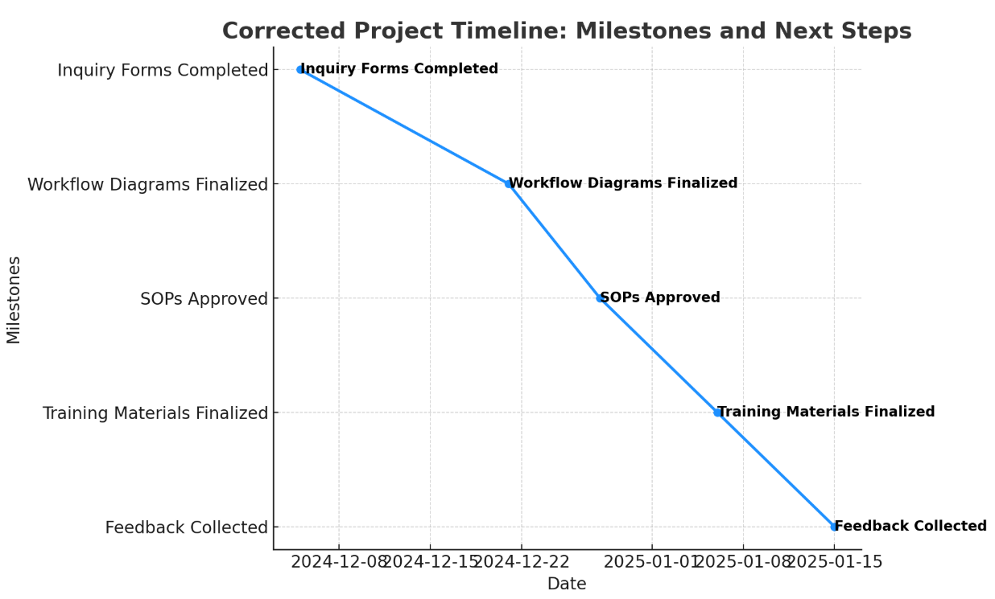
Progress and Next Steps (with Dependencies)
Milestones Achieved:
Inquiry forms completed (Dec 5, 2024).
Workflow diagrams in progress (Expected Dec 21, 2024).
SOPs under review (Expected Dec 28, 2024).
Next Steps (Dependencies Highlighted):
Finalize Training Materials (Jan 6, 2025): Dependent on the approval and finalization of SOPs.
Gather and Analyze Feedback (Jan 15, 2025): Requires training materials to be distributed and initial training sessions to be conducted.
Notes:
The project’s next steps rely on the timely finalization of SOPs to ensure accurate training materials are created.
Feedback collection is contingent on the distribution and use of training materials during sessions. These dependencies ensure sequential alignment and efficient progress toward the project’s goals.

Slide 10
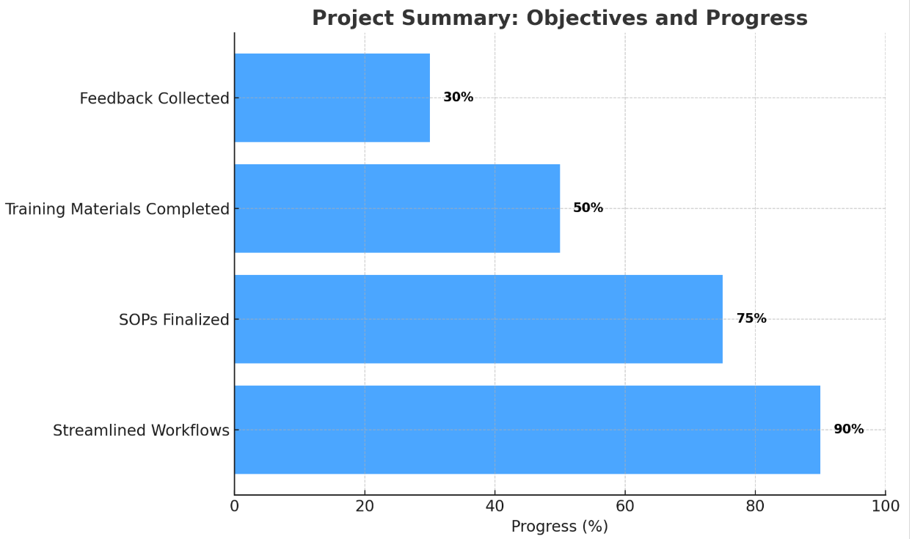
Questions and Feedback
Let’s Collaborate:
“What are your thoughts on our progress so far?”
“Are there any suggestions or concerns for the next phase?”
Notes:
Let’s take this opportunity to hear your thoughts and ideas. Your feedback is invaluable in helping us refine the project and ensure it aligns with everyone’s expectations. Every suggestion or concern you share plays a vital role in strengthening the overall outcome. We truly value your input and look forward to collaborating on the next steps!

